Slide 1
Activities
Final Activity

Slide 2
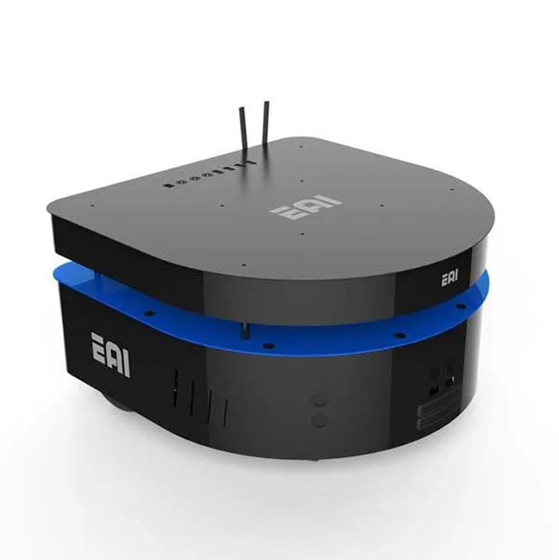
Final Activity
This challenge is intended for the student to review the concepts introduced in this week.
  Closed control of a simulated robot in Gazebo.

Slide 3
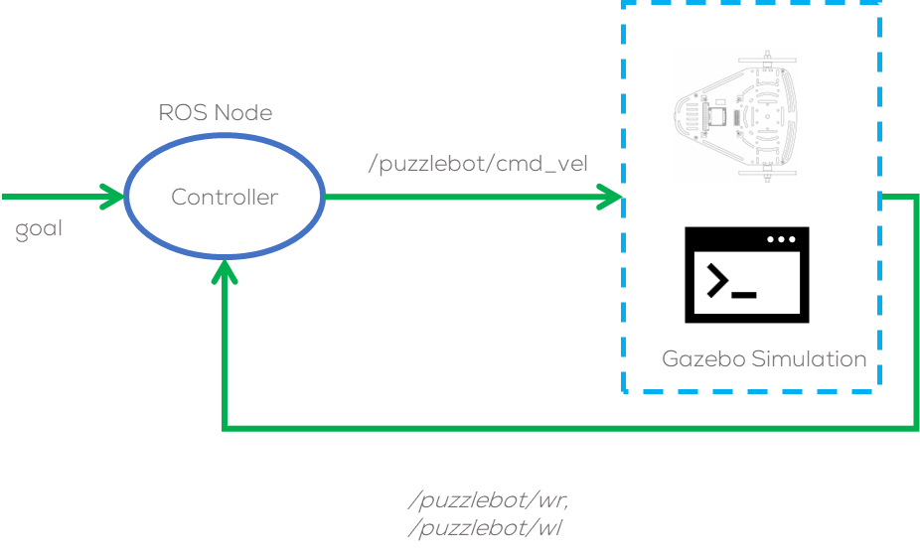
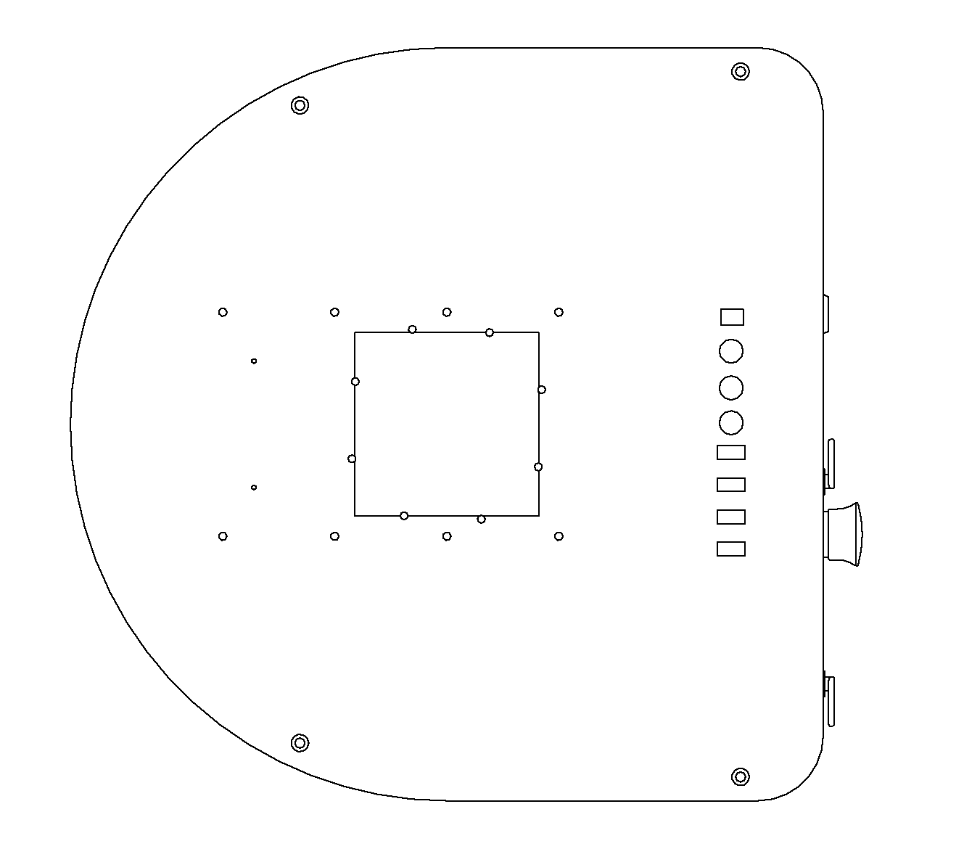
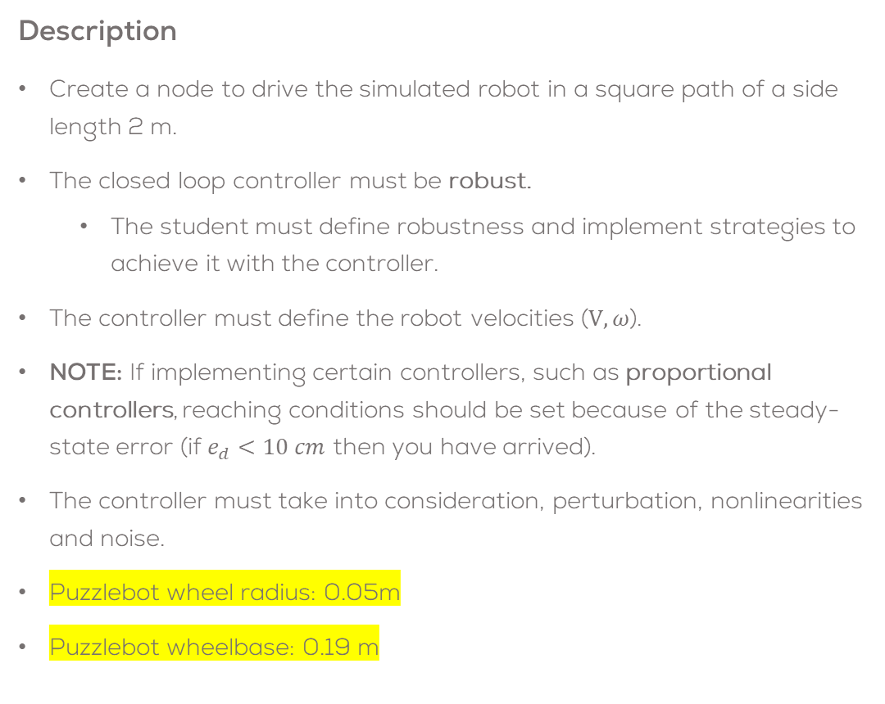
Final Activity
Description
Create a node to drive the simulated robot in a square path of a side length 2 m.
The closed loop controller must be robust.
  The student must define robustness and implement strategies to achieve it with the controller.
The controller must define the robot velocities ($V, ω$).
NOTE: If implementing certain controllers, such as proportional controllers, reaching conditions should be set because of the steady-state error (if $e_{d}<10 cm$ then you have arrived).
The controller must take into consideration, perturbation, nonlinearities and noise.
Puzzlebot wheel radius: 0.05m
Puzzlebot wheelbase: 0.19 m
2 m
2 m

Slide 4
Deliverables
The student must submit a video showing their results.
Duration: Under 4 min. (If longer, increase speed)
Show face, name and student ID number.
Video in English (preferred) or Spanish
Upload to CANVAS
This is an engineering report (it will be graded accordingly):
  Use the third-person
  Do not use expressions like “the controller works well”, “it's fine”, “robust”, “optimal”, etc. unless you can prove it (be serious with your results).
  Use different metrics (maybe error-based) to analyse your system.
  Show plots of the set points, control inputs, errors, and system output and use them to analyse the behaviour.
  Do not conclude things like “I learned a lot”, “it was very challenging”, “everything looks fine”, etc. Conclusions based on the results, problems faced, solutions, etc.
Tasks
Brief introduction (problem to be solved, solution strategy, team tasks, etc.)
Explain how the program works (launch files, libraries made, the structure of the project, etc.). Use the code but also use flowcharts to explain the code If using your own controller, explain in this section the code, parameters, inputs and outputs of your model.
Show the results of the robot being controlled. Try different scenarios (other setpoints to control the robot)
Explain the methodology followed to tune the controller parameters
Analysis of the robot’s behaviour. What is expected? Is the behaviour good? Why? Establish a metric to verify if the behaviour of the robot is good or not. Advantages/disadvantages of this type of control? Problems with this type of control?
A brief set of conclusions from the task. The conclusions should be about the practice and the theoretical aspects of the robot, not about your personal experiences.

Slide 5
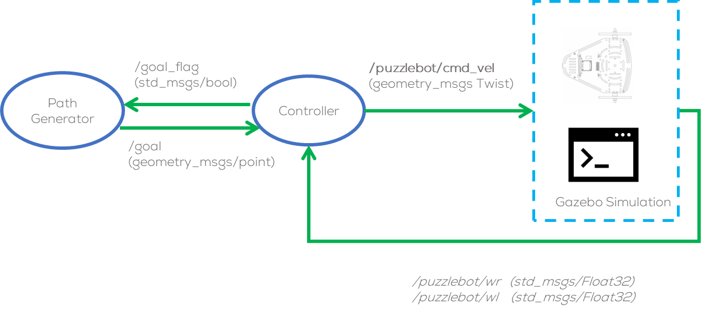
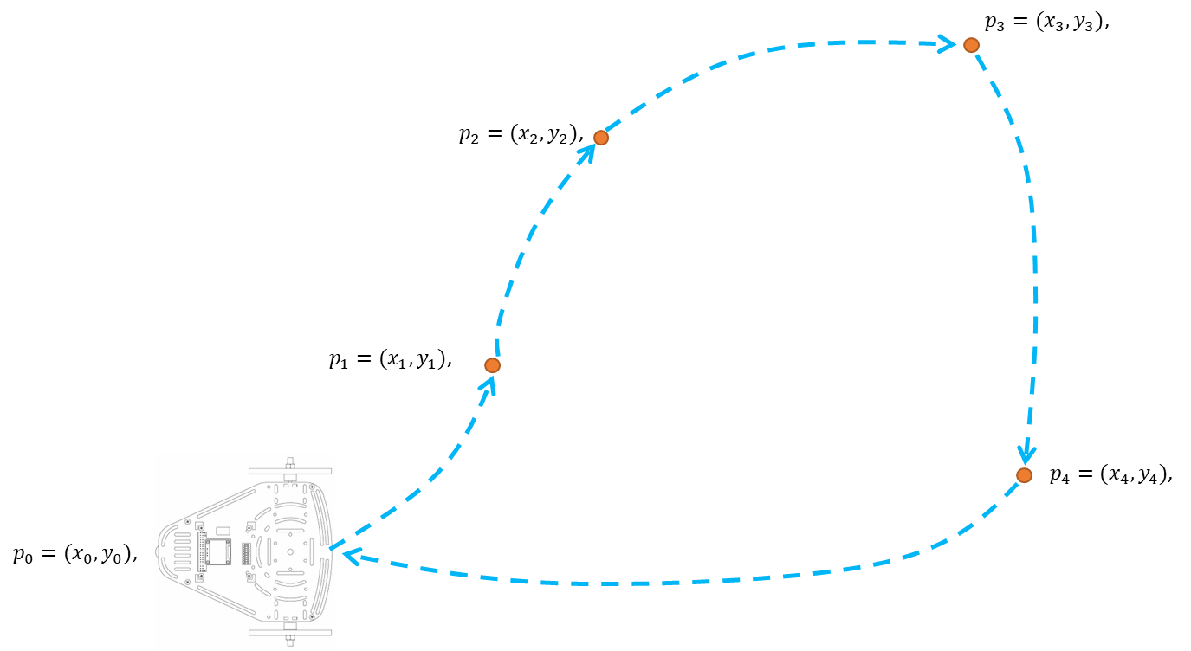
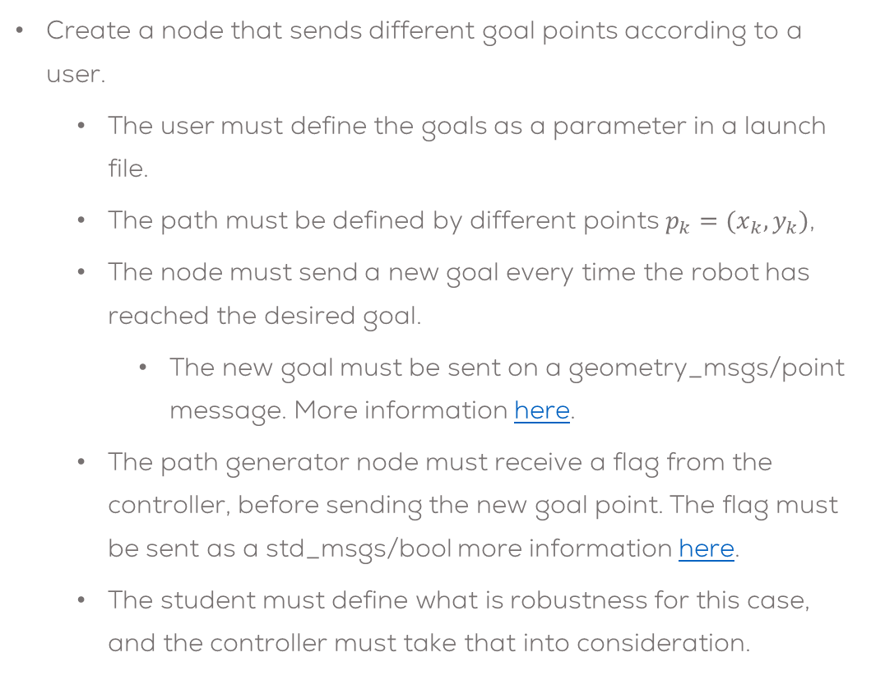
Extra Marks
Create a node that sends different goal points according to a user.
  The user must define the goals as a parameter in a launch file.
  The path must be defined by different points $p_{k}=(x_{k},y_{k})$,
  The node must send a new goal every time the robot has reached the desired goal.
    The new goal must be sent on a geometry_msgs/point message. More information here.
  The path generator node must receive a flag from the controller, before sending the new goal point. The flag must be sent as a std_msgs/bool more information here.
  The student must define what is robustness for this case, and the controller must take that into consideration.

Slide 6
Tips
Not arrived
to goal
Go to Goal
Arrived at goal
Set Next Goal
Start?
Variables ready? Simulation ready?
Next Goal Set
Stop
Start
All goals reached

Slide 7
Rules
This is challenge not a class. The students are encouraged to research, improve tune explain their algorithms by themselves.
MCR2(Manchester Robotics) Reserves the right to answer a question if it is determined that the questions contains partially or totally an answer.
The students are welcomed to ask only about the theoretical aspect of the classed.
No remote control or any other form of human interaction with the simulator or ROS is allowed (except at the start when launching the files).
It is forbidden to use any other internet libraires with the exception of standard libraires or NumPy.
If in doubt about libraires please ask any teaching assistant.
Improvements to the algorithms are encouraged and may be used as long as the students provide the reasons and a detailed explanation on the improvements.
All the students must be respectful towards each other and abide by the previously defined rules.
Manchester robotics reserves the right to provide any form of grading. Grading and grading methodology are done by the professor in charge of the unit.

